Slide 1
TRANSPORT LAYER

Slide 2
Introduction
TCP is a Transmission Control Protocol.
It is a connection oriented protocol; it creates virtual connection between two nodes to send data.
TCP is a connection oriented , reliable transport protocol

Slide 3
TCP SERVICES
Services offered by TCP to the processes at the application layer
    Process-to-process communication
    Stream delivery services
    Full duplex communication
    Connection oriented services
    Reliable service

Slide 4
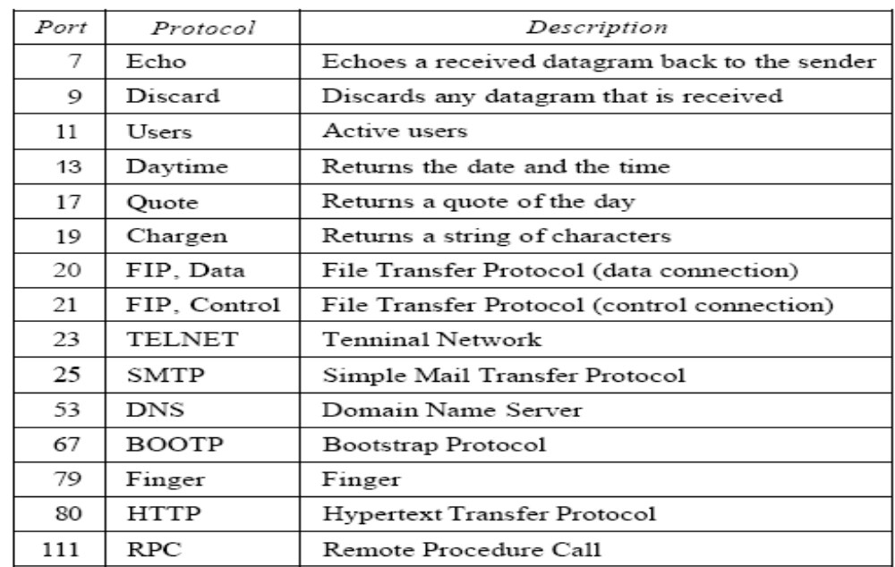
Process-to-process communication
Like UDP, TCP provides process-to-process communication using port numbers

Slide 5
Stream delivery services
TCP is a stream oriented protocol.
TCP creates an environment for sending and receiving processes as a stream of bytes.
TCP needs buffer for storage as the sending and receiving process may not read or write data at the same speed.
There are two buffer one for each direction and a simple buffer can be implemented by circular array

Slide 6
IP layer as a service provider for TCP, need to send data in packets, and not as a stream of byes.
At the transport layer, TCP groups a number of bytes together into a packet called a segment.
TCP adds a header to each segment and delivers the segment to the IP layer for transmission.
Segments may be received out of order, lost, or corrupted and resent. All these are handled by TCP with the receiving process.
Segments are not necessarily the same size.

Slide 7
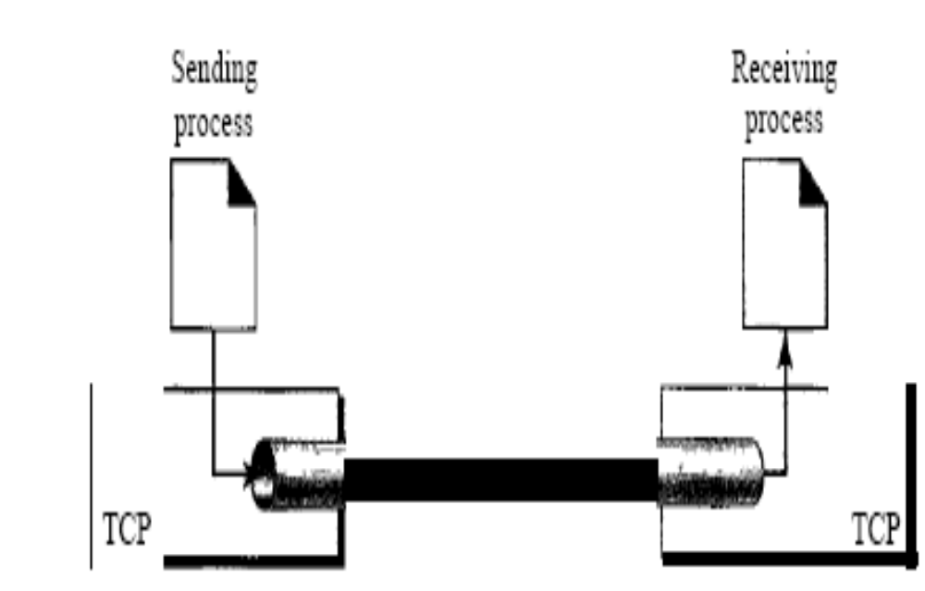

Slide 8
Full duplex communication
TCP offers full duplex service, in which data can flow in both directions at the same time

Slide 9
Connection oriented service
TCP needs the following:
    The two TCP establish a connection between them
    Data are exchanged in both directions
    The connection is terminated
This is a virtual connection; TCP creates a stream oriented environment in which it accepts the responsibility of delivering the bytes in order to the other site.

Slide 10
Reliable services
TCP is a reliable transport protocol.
It uses an acknowledgment mechanism to check the safe and sound arrival of data

Slide 11
TCP Features
Numbering systems
Although the TCP software keeps track of the segments being transmitted or received, there is no field for a segment number value in the segment header.
Instead, there are two fields called the sequence no. and the acknowledgment no.
These two fields refer to the byte number and not the segment number

Slide 12
TCP Features(contd..)
Sequence Number
The bytes have been numbered; TCP assigns a sequence number to each segment that is being sent.
The sequence number for each segment is the number of the first byte carried in that segment.

Slide 13
Segment
A packet in TCP is called a segment. TCP segment format as follows:
    The segment consists of a 20-byte to 60-byte header, followed by data from the application program.
    The header is 20 bytes if there are no options.

Slide 14
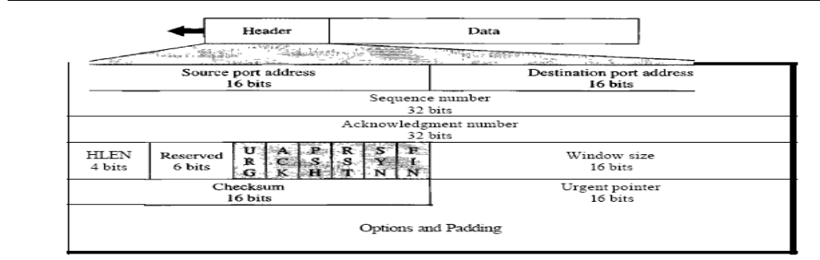
Source port address: This is a 16-bit field that defines the port number of the application program in the host that is sending the segment.
Destination port address: This is a 16-bit field that defines the port number of the application program in the host that is receiving the segment.

Slide 15
Sequence number:
  This 32-bit field defines the number assigned to the first byte of data contained in this segment.

Slide 16
Acknowledgment number.
  32-bit field defines the byte number that the receiver of the segment is expecting to receive from the other party.
  If the receiver of the segment has successfully received byte number x from the other party, it defines x + I as the acknowledgment number.
  Acknowledgment and data can be piggybacked together.

Slide 17
Header length:
This 4-bit field indicates the number of 4-byte words in the TCP header.
The length of the header can be between 20 and 60 bytes. Therefore, the value of this field can be between 5 (5 x 4 =20) and 15 (15 x 4 =60).
Reserved: This is a 6-bit field reserved for future use

Slide 18
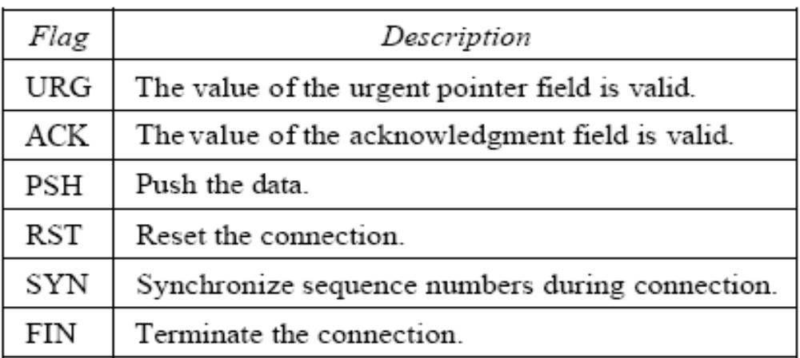
Control:
This field defines 6 different control bits or flags.

Slide 19
Window size:
  defines the size of the window, in bytes, that the other party must maintain.
  Note that the length of this field is 16 bits, which means that the maximum size of the window is 65,535 bytes.
  This value is normally referred to as the receiving window (rwnd) and is determined by the receiver.
  The sender must obey the dictation of the receiver in this case.

Slide 20
Checksum:
  16-bit field contains the checksum.
  calculation of the checksum for TCP follows the same procedure for UDP.
  inclusion of the checksum for TCP is mandatory.

Slide 21
Urgent pointer:
  l6-bit field which is valid only if the urgent flag is set and it is used when the segment contains urgent data.
  It defines the number that must be added to the sequence number to obtain the number of the last urgent byte in the data section of the segment.

Slide 22
Options:
  There can be up to 40 bytes of optional information in the TCP header.

Slide 23
FLOW CONTROL
Flow control regulates the amount of data a source can send before receiving an acknowledgment from the destination.
A transport layer protocol can send all of the data without worrying about acknowledgments.
If some part of the data is lost, duplicated, received out of order, or corrupted the source will not know until all has been checked by the destination.
It defines a window that is imposed on the buffer of data delivered from the application program and ready to be sent.
TCP sends an amount of data defined by the sliding window protocol

Slide 24
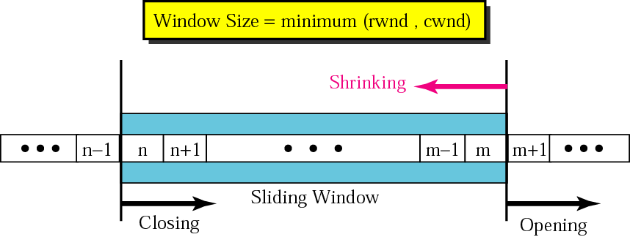
Sliding window protocol
To accomplish flow control, TCP uses a sliding window protocol

Slide 25
Sliding window protocol
A sliding window is used to make transmission more efficient as well as to control the flow of data so that the destination does not become overwhelmed with data. TCP’s sliding windows are byte oriented
The imaginary window has two walls: one left and one right. The window is called sliding window because the wall can slide
The window is opened, closed, or shrunk. These three activities are in the control of the receiver not the sender
The size of the window at one end, is determined by the lesser of two values: receiver window(rwnd) or congestion window(cwnd).

Slide 26
Receiver window
The receiver window is the value advertised by the opposite end in a segment containing acknowledgment.
It is the number of bytes the other end can accept before its buffer overflows and data is discarded

Slide 27
Congestion window
The congestion window is a value determined by the network to avoid congestion

Slide 28
Silly Window Syndrome
If either sender or receiver slow down significantly, results in very small segments.
An extreme are one byte segments, causing IP packets of size 41 carrying only one byte of data (20 - IP header, 20-TCP header, 1-payload).
This is very inefficient use of network, called silly window syndrome.

Slide 29
Silly Window Syndrome
Nagle’s algorithm is a simple and effective solution to that.
if (available data and window > MSS)
Send a full segment;
else
if (there is unacknowledged data in flight)
Buffer the new data until ACK arrives;
else
Send all the new data now;

Slide 30
Silly Window Syndrome
Two solutions have been proposed to prevent the silly window syndrome created by an application program that consumes data slower than they arrive
  Clark’s solution:
  send an acknowledgment as soon as the data arrives, but to announce a window size of zero until either there is enough space to accommodate a segment of maximum size or until half of the buffer is empty.

Slide 31
  Delayed Acknowledgment : when a segment arrives, it is not acknowledged immediately. The receiver waits until there is a decent amount of space in its incoming buffer before acknowledging the arrived segments. The delayed acknowledgment prevents the sending TCP from sliding its window. After it has sent the data in the window. It stops. This kills the syndrome.

Slide 32
DATA TRAFFIC
The main focus of congestion control is data traffic.
Traffic Descriptor are qualitative values that represent a data flow

Slide 33
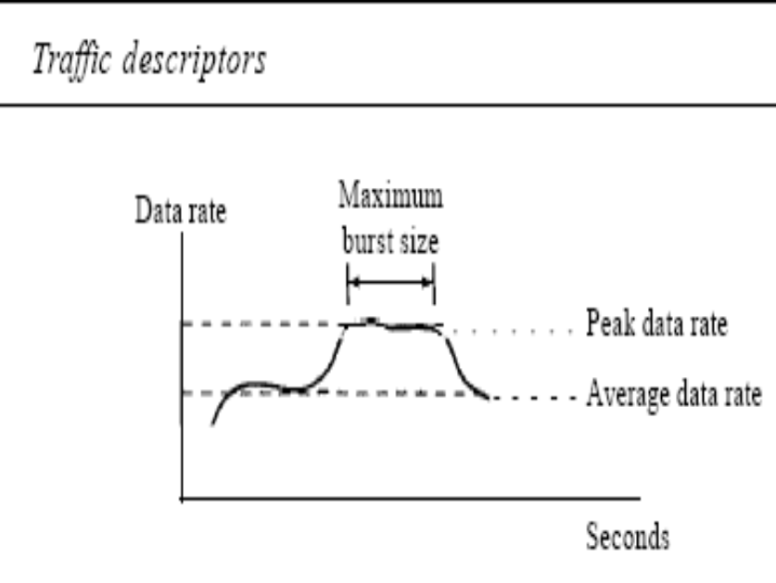

Slide 34
Average Data Rate
The average data rate is the number of bits sent during a period of time, divided by the number of seconds in that period. We use the following equation:
  Average data rate =amount of data/ time
The average data rate is a very useful characteristic of traffic because it indicates the average bandwidth needed by the traffic.

Slide 35
Peak Data Rate
The peak data rate defines the maximum data rate of the traffic. The peak data rate is a very important measurement because it indicates the peak bandwidth that the network needs for traffic to pass through without changing its data flow.
Maximum Burst Size
Although the peak data rate is a critical value for the network, it can usually be ignored if the duration of the peak value is very short.
For example, if data are flowing steadily at the rate of 1 Mbps with a sudden peak data rate of 2 Mbps for just 1 ms the network probably can handle the situation. However, if the peak data rate lasts 60 ms, there may be a problem for the network. The maximum burst size normally refers to the maximum length of time the traffic is generated at the peak rate

Slide 36
Effective Bandwidth
The effective bandwidth is the bandwidth that the network needs to allocate for the flow of traffic.
The effective bandwidth is a function of three values: average data rate, peak data rate, and maximum burst size.
The calculation of this value is very complex.

Slide 37
Traffic Profiles
A data flow can have one of the following traffic profiles:
  constant bit rate
  variable bit rate
  bursty

Slide 38
Constant Bit Rate
A constant-bit-rate (CBR), or a fixed-rate, traffic model has a data rate that does not change.
In this type of flow, the average data rate and the peak data rate are the same. The maximum burst size is not applicable.
This type of traffic is very easy for a network to handle since it is predictable.
The network knows in advance how much bandwidth to allocate for this type of flow

Slide 39
Variable Bit Rate
In the variable-bit-rate (VBR) category, the rate of the data flow changes in time, with the changes smooth instead of sudden and sharp.
In this type of flow, the average data rate and the peak data rate are different.
The maximum burst size is usually a small value.
This type of traffic is more difficult to handle than constant-bit-rate traffic, but it normally does not need to be reshaped

Slide 40
Bursty
In the bursty data category, the data rate changes suddenly in a very short time. It may jump from zero, for example, to 1 Mbps in a few microseconds and vice versa.
It may also remain at this value for a while. The average bit rate and the peak bit rate are very different values in this type of flow.
The maximum burst size is significant. This is the most difficult type of traffic for a network to handle because the profile is very unpredictable. To handle this type of traffic, the network normally needs to reshape it, using reshaping techniques, Bursty traffic is one of the main causes of congestion in a network

Slide 41
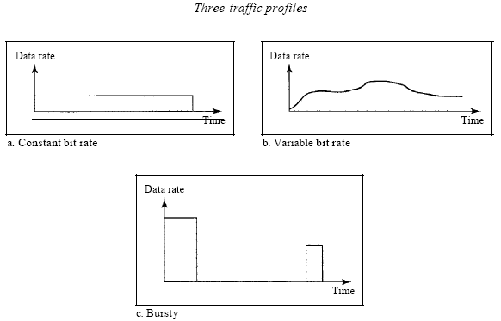

Slide 42
CONGESTION
Congestion in a network may occur if the load on the network i.e., the number of packets sent to the network is greater than the capacity of the network.
Congestion control refers to the mechanisms and techniques to control the congestion and keep the load below the capacity

Slide 43
When a packet arrives at the incoming interface, it undergoes three steps before departing:
The packet is put at the end of the input queue while waiting to be checked.
The processing module of the router removes the packet from the input queue once it reaches the front of the queue and uses its routing table and the destination address to find the route.
The packet is put in the appropriate output queue and waits its turn to be sent. If the rate of packet arrival is higher than the packet processing rate, the input queues become longer and longer. Second, if the packet departure rate is less than the packet processing rate, the output queues become longer and longer

Slide 44
CONGESTION CONTROL
Congestion control refers to techniques and mechanisms that can either prevent congestion, before it happens, or remove congestion, after it has happened.
we can divide congestion control mechanisms into two broad categories:
  open-loop congestion control (prevention)
  closed-loop congestion control (removal)

Slide 45
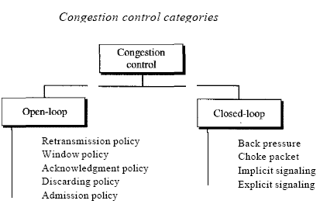

Slide 46
Open-Loop Congestion Control
In open-loop congestion control, policies are applied to prevent congestion before it happens.
In these mechanisms, congestion control is handled by either the source or the destination.

Slide 47
List of policies that can prevent congestion
Retransmission Policy
Retransmission is sometimes unavoidable. If the sender feels that a sent packet is lost or corrupted, the packet needs to be retransmitted.
Retransmission in general may increase congestion in the network. However, a good retransmission policy can prevent congestion.
The retransmission policy and the retransmission timers must be designed to optimize efficiency and at the same time prevent congestion.
For example, the retransmission policy used by TCP is designed to prevent or alleviate congestion.

Slide 48
Window Policy
The type of window at the sender may also affect congestion. The Selective Repeat window is better than the Go-Back-N window for congestion control.
In the Go-Back-N window, when the timer for a packet times out, several packets may be resent, although some may have arrived safe and sound at the receiver.
This duplication may make the congestion worse.
The Selective Repeat window, on the other hand, tries to send the specific packets that have been lost or corrupted

Slide 49
Acknowledgment Policy
The acknowledgment policy imposed by the receiver may also affect congestion.
If the receiver does not acknowledge every packet it receives, it may slow down the sender and help prevent congestion.
Several approaches are used in this case.
A receiver may send an acknowledgment only if it has a packet to be sent or a special timer expires.
A receiver may decide to acknowledge only N packets at a time.
We need to know that the acknowledgments are also part of the load in a network.
Sending fewer acknowledgments means imposing less load on the network.

Slide 50
Discarding Policy
A good discarding policy by the routers may prevent congestion and at the same time may not harm the integrity of the transmission.
For example, in audio transmission, if the policy is to discard less sensitive packets when congestion is likely to happen, the quality of sound is still preserved and congestion is prevented or alleviated

Slide 51
Admission Policy
An admission policy, which is a quality-of-service mechanism, can also prevent congestion in virtual-circuit networks.
Switches in a flow first check the resource requirement of a flow before admitting it to the network.
A router can deny establishing a virtual circuit connection if there is congestion in the network or if there is a possibility of future congestion.

Slide 52
Closed-Loop Congestion Control
Closed-loop congestion control mechanisms try to alleviate congestion after it happens
Backpressure
The technique of backpressure refers to a congestion control mechanism in which a congested node stops receiving data from the immediate upstream node or nodes.
This may cause the upstream node or nodes to become congested, and they, in turn, reject data from their upstream nodes or nodes. And so on.
Backpressure is a node-to-node congestion control that starts with a node and propagates, in the opposite direction of data flow, to the source.
The backpressure technique can be applied only to virtual circuit networks, in which each node knows the upstream node from which a flow of data is corning

Slide 53
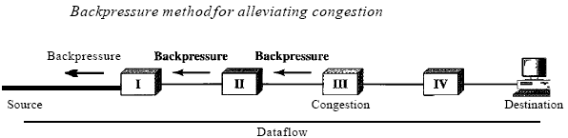

Slide 54
Choke Packet
A choke packet is a packet sent by a node to the source to inform it of congestion.
Note the difference between the backpressure and choke packet methods.
In backpressure, the warning is from one node to its upstream node, although the warning may eventually reach the source station.
In the choke packet method, the warning is from the router, which has encountered congestion, to the source station directly.
The intermediate nodes through which the packet has traveled are not warned

Slide 55
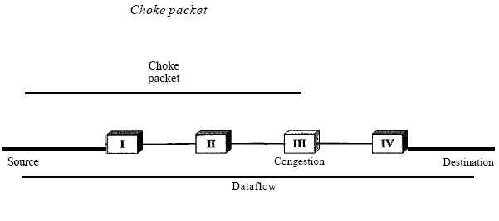

Slide 56
Implicit Signaling
In implicit signaling, there is no communication between the congested node or nodes and the source.
The source guesses that there is a congestion somewhere in the network from other symptoms.
For example, when a source sends several packets and there is no acknowledgment for a while, one assumption is that the network is congested.
The delay in receiving an acknowledgment is interpreted as congestion in the network; the source should slow down

Slide 57
Explicit Signaling
The node that experiences congestion can explicitly send a signal to the source or destination.
The explicit signaling method, however, is different from the choke packet method.
In the choke packet method, a separate packet is used for this purpose; in the explicit signaling method, the signal is included in the packets that carry data.
Explicit signaling, as we will see in Frame Relay congestion control, can occur in either the forward or the backward direction

Slide 58
Backward Signaling
A bit can be set in a packet moving in the direction opposite to the congestion.
This bit can warn the source that there is congestion and that it needs to slow down to avoid the discarding of packets.

Slide 59
Forward Signaling
A bit can be set in a packet moving in the direction of the congestion. This bit can warn the destination that there is congestion.
The receiver in this case can use policies, such as slowing down the acknowledgments, to alleviate the congestion.

Slide 60
Congestion control in TCP
Congestion Window
The sender has two pieces of information
  receiver-advertised window size
  congestion window size.
The actual size of the window is the minimum of these two.
    Actual window size=minimum(rwnd,cwnd)

Slide 61
Congestion Policy
TCP’s general policy for handling congestion is based on three phases: slow start, congestion avoidance and congestion detection.
In the slow start phase, the sender starts with a very slow rate of transmission, but increases the rate rapidly to reach a threshold.
When the threshold is reached, the data rate is reduced to avoid congestion.
Finally if congestion is detected, the sender goes back to the slow start or congestion avoidance phase based on how the congestion is detected

Slide 62
Slow Start: Exponential Increase
One of the algorithms used in TCP congestion control is called slow start.
This algorithm is based on the idea that the size of the congestion window starts with one maximum segment size (MSS).
The size of the window increases one MSS each time one segment is acknowledged. As the name implies. The algorithm starts slowly, but grows exponentially.
The sender starts with cwnd = 1 MSS.
This means that the sender can send only one segment. After receiving the acknowledgement for segment 1, the size of the congestion window is increased by 1, which means that cwnd is now 2.
Now two more segment can be sent. When the two segments are acknowledged, the size of the window is increased by 1 MSS for each acknowledged segment, which means cwnd is 4.
Now four more segments can be sent.
When all four segments are acknowledged, the size of the window increases by 4, which means that cwnd=8.
Slow start cannot continue indefinitely.
There must be a threshold to stop this phase. The sender keeps track of a variable named ssthresh (slow start threshold).
When the size of window in bytes reaches this threshold, slow start stops and the next phase starts.
In most implementations the value of ssthresh is 65535 bytes.

Slide 63
Additive Increase/Multiplicative Decrease
TCP maintains a new state variable for each connection, called Congestion Window, which is used by the source to limit how much data it is allowed to have in transit at a given time
TCP’s effective window
  MaxWindow = MIN(CongestionWindow, Advertised Window)
  EffectiveWindow = MaxWindow − (LastByteSent − LastByteAcked).
TCP source sets the CongestionWindow based on the level of congestion it perceives to exist in the network.
This involves decreasing the congestion window when the level of congestion goes up and increasing the congestion window when the level of congestion goes down. Taken together, the mechanism is commonly called additive increase/multiplicative decrease (AIMD)

Slide 64
Congestion Window is not allowed to fall below the size of a single packet, or in TCP terminology, the maximum segment size (MSS) to increase the congestion window to take advantage of newly available capacity in the network. This is the “additive increase
Packets in transit during additive increase, with one packet being added each RTT

Slide 65
The congestion window is incremented as follows each time an ACK arrives:
Increment = MSS × (MSS/Congestion Window)
Congestion Window + = Increment
We increment congestion window by a fraction of MSS every time an ACK is received that fraction is MSS/ Congestion Window
This pattern of continually increasing and decreasing the congestion window continues throughout the lifetime of the connection.
The important concept to understand about AIMD is that the source is willing to reduce its congestion window at a much faster rate than it is willing to increase its congestion window

Slide 66
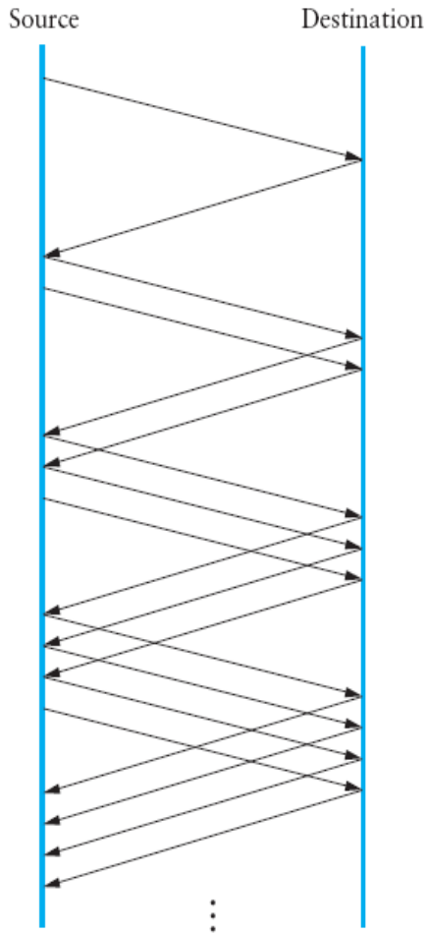
Packets in transit during additive increase, with one packet being added each RTT.

Slide 67
Congestion Avoidance: Additive Increase
If we start with the slow start algorithm, the size of the congestion window increases exponentially.
To avoid congestion before it happens, one must slow down this exponential growth. TCP defines another algorithm called congestion avoidance, which increases additively instead of exponentially.
When the size of the congestion window reaches the slow start threshold, the slow start phase stops and the additive phase begins.
In this algorithm, each time the whole window of segments is acknowledged, the size of the congestion window is increased by one.
The congestion avoidance algorithm usually starts when the size of the window is much greater than 1 after the sender has received acknowledgments for a complete window size of segments; the size of the window is increased one segment

Slide 68
Congestion Detection : Multiplicative Decrease
If congestion occurs, the congestion window size must be decreased.
The only way the sender can guess that congestion has occurred is the need to retransmit a segment.
Retransmission can occur in one of two cases:
  When an RTO timer times out
  When three ACKs are received.
In both cases, the size of the threshold is dropped to half

Slide 69
Most TCP implementations have two reactions:
If a time-out occurs, there is a stronger possibility of congestion: a segment has probably been dropped in the network and there is no news about the following sent segments. In this case TCP reacts strongly:
It sets the value of the threshold to half of the current window size
It sets cwnd to the size of one segment
It starts the slow start phase again
If three ACK s are received, there is a weaker possibility of congestion; a segment may have been dropped but some segments after that may have arrived safely since three ACK are received. This is called fast transmission and fast
recovery. In this case, TCP has a weaker reaction as shown below
It sets the value of the threshold to half of the current window size
It sets cwnd to the value of the threshold
It starts the congestion avoidance phase

Slide 70
Fast Retransmit and Fast Recovery
Fast retransmit retransmission of a dropped packet sooner than the regular timeout mechanism The fast retransmit mechanism does not replace regular timeouts; it just enhances that facility
The idea of fast retransmit is straightforward.
Every time a data packet arrives at the receiving side, the receiver responds with an acknowledgment, even if this sequence number has already been acknowledged.
Thus, when a packet arrives out of order— that is, TCP cannot yet acknowledge the data the packet contains because earlier data has not yet arrived—TCP resends the same acknowledgment it sent the last time.

Slide 71
This second transmission of the same acknowledgment is called a duplicate ACK. When the sending side sees a duplicate ACK, it knows that the other side must have received a packet out of order, which suggests that an earlier packet might have been lost.
Since it is also possible that the earlier packet has only been delayed rather than lost, the sender waits until it sees some number of duplicate ACKs and then retransmits the missing packet.
In practice, TCP waits until it has seen three duplicate ACKs before retransmitting the packet.

Slide 72
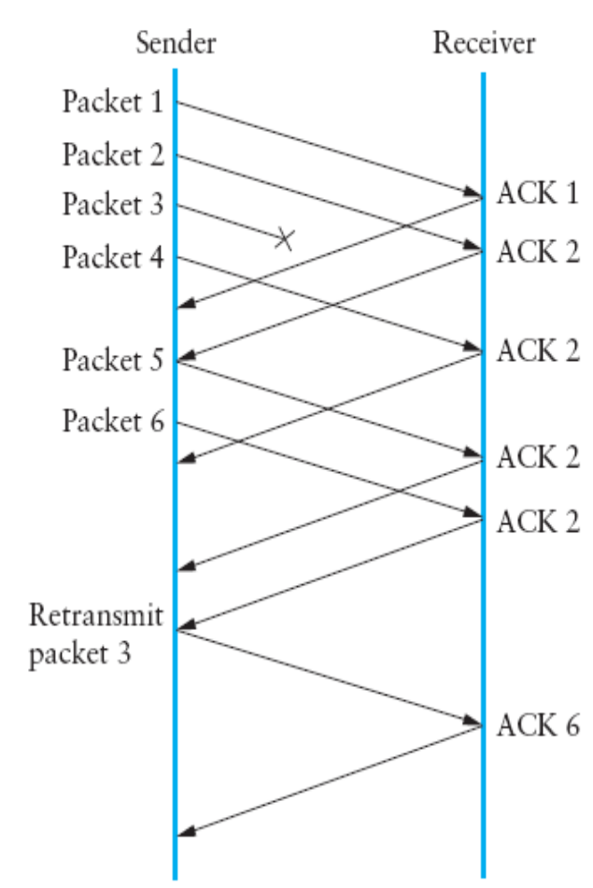
Fast retransmit based on duplicate ACKs.

Slide 73
The fast retransmit mechanism signals congestion, rather than drop the congestion window all the way back to one packet and run slow start, it is possible to use the ACKs that are still in the pipe to clock the sending of packets.
This mechanism, which is called fast recovery, effectively removes the slow start phase that happens between when fast retransmit detects a lost packet and additive increase begins.

Slide 74
TECHNIQUES TO IMPROVE QoS
Scheduling
Packets from different flows arrive at a switch or router for processing. A good scheduling technique treats the different flows in a fair and appropriate manner.
Several scheduling techniques are designed to improve the quality of service. We discuss three of them here:
FIFO queuing, priority queuing, and weighted fair queuing

Slide 75
FIFO Queuing
In first-in, first-out (FIFO) queuing, packets wait in a buffer (queue) until the node (router or switch) is ready to process them.
If the average arrival rate is higher than the average processing rate, the queue will fill up and new packets will be discarded.

Slide 76
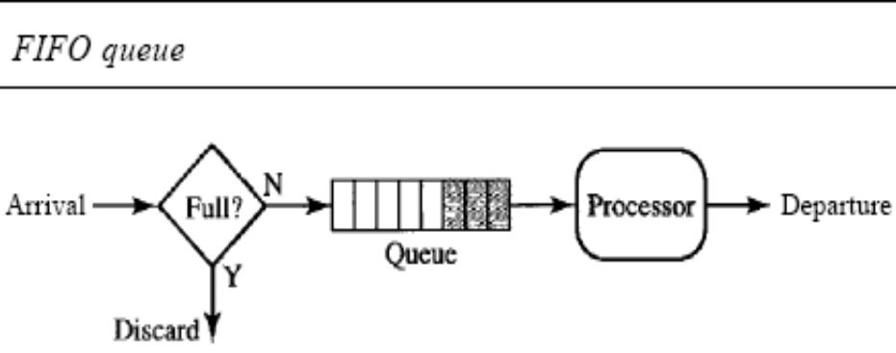

Slide 77
Priority Queuing
In priority queuing, packets are first assigned to a priority class. Each priority class has its own queue.
The packets in the highest-priority queue are processed first. Packets in the lowest-priority queue are processed last.
Note that the system does not stop serving a queue until it is empty.
A priority queue can provide better QoS than the FIFO queue because higher priority traffic, such as multimedia, can reach the destination with less delay.
However, there is a potential drawback.
If there is a continuous flow in a high-priority queue, the packets in the lower-priority queues will never have a chance to be processed. This is a condition called starvation

Slide 78
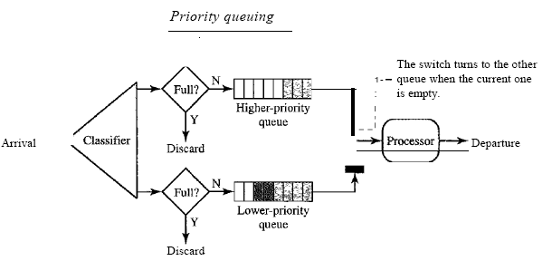

Slide 79
Weighted Fair Queuing
A better scheduling method is weighted fair queuing.
In this technique, the packets are still assigned to different classes and admitted to different queues.
The queues, however, are weighted based on the priority of the queues; higher priority means a higher weight.
The system processes packets in each queue in a round-robin fashion with the number of packets selected from each queue based on the corresponding weight

Slide 80
Traffic Shaping
Traffic shaping is a mechanism to control the amount and the rate of the traffic sent to the network.
Two techniques can shape traffic: leaky bucket and token bucket.

Slide 81
Leaky Bucket
If a bucket has a small hole at the bottom, the water leaks from the bucket at a constant rate as long as there is water in the bucket.
The rate at which the water leaks does not depend on the rate at which the water is input to the bucket unless the bucket is empty.
The input rate can vary, but the output rate remains constant. Similarly, in networking, a technique called leaky bucket can smooth out bursty traffic.
Bursty chunks are stored in the bucket and sent out at an average rate.

Slide 82
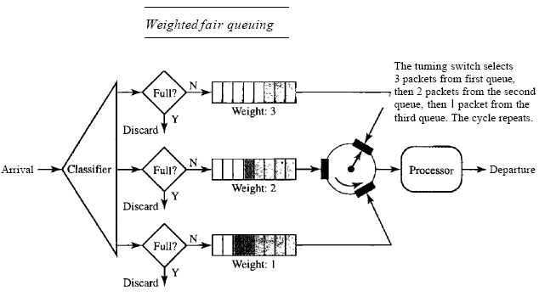

Slide 83
Resource Reservation
A flow of data needs resources such as a buffer, bandwidth, CPU time, and so on. The quality of service is improved if these resources are reserved beforehand.
Admission Control
Admission control refers to the mechanism used by a router, or a switch, to accept or reject a flow based on predefined parameters called flow specifications.
Before a router accepts a flow for processing, it checks the flow specifications to see if its capacity (in terms of bandwidth, buffer size, CPU speed, etc.) and its previous commitments to other flows can handle the new flow.

Slide 84
Remote procedure call
RPC is a powerful technique for constructing distributed, client-server based applications. it is based on the semantics of a local procedure call
The application program makes a call into a procedure without regard for whether it is local or remote and blocks until the call returns

Slide 85
There are two main problems that make RPC more complicated than local procedure calls
The network between the calling process and the called process has much more complex properties than the backplane of a computer. For example, it is likely to limit message sizes and has a tendency to lose and reorder messages
The computers on which the calling and called processes run may have significantly different architectures and data representation formats.

Slide 86
Major components of RPC
  A protocol that manages the messages sent between the client and the server processes and that deals with the potentially undesirable properties of the underlying network
  Programming language and compiler support to package the arguments into a request message on the client machine and then to translate this message back into the arguments on the server machine, and likewise with the return value

Slide 87
The client calls a local stub for the procedure, passing it the arguments required by the procedure. This stub hides the fact that the procedure is remote by translating the arguments into a request message and then invoking an RPC protocol to send the request message to the server machine.
At the server, the RPC protocol delivers the request message to the server stub, which translates it into the arguments to the procedure and then calls the local procedure.
After the server procedure completes, it returns the answer to the server stub, which packages this return value in a reply message that it hands off to the RPC protocol for transmission back to the client. The RPC protocol on the client passes this message up to the client stub, which translates it into a return value that it returns to the client program.

Slide 88
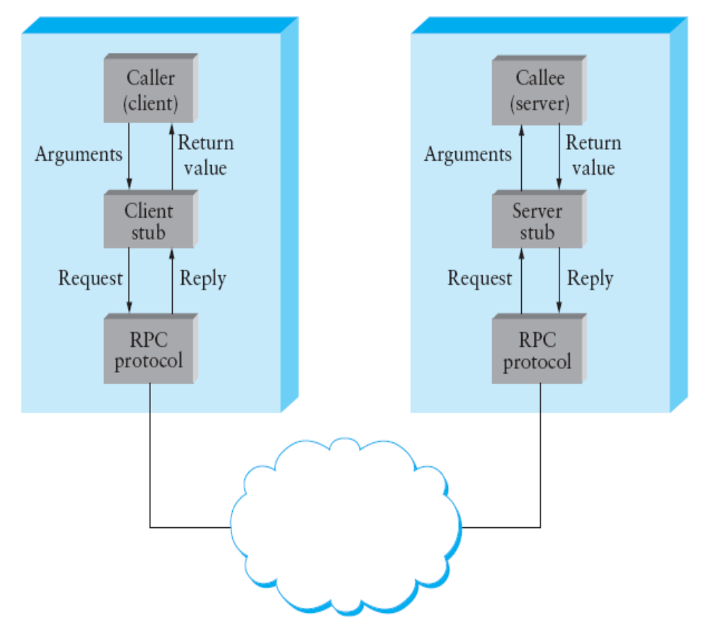

Slide 89
This section considers the protocol-related aspects of an RPC mechanism. That is, it ignores the stubs and focuses instead on the RPC protocol that transmits messages between client and server.
Process involved in designing an RPC protocol: we developed a simple RPC protocol as a “stack” of three smaller protocols: BLAST, CHAN, and SELECT. Each of these smaller protocols, which we sometimes call a micro protocol, contains a single algorithm that addresses one of the problems
  BLAST: fragments and reassembles large messages
  CHAN: synchronizes request and reply messages
  SELECT: dispatches request messages to the correct process
These micro protocols are complete, self-contained protocols that can be used in different combinations to provide different end-to-end services.
Two widely used RPC protocols
SunRPC
DCE-RPC

Slide 90
SunRPC
SunRPC has also not been approved by any standardization body, but it has become a de facto standard. The IETF is considering officially for adopting SunRPC as a standard Internet protocol.
SunRPC addresses fragmenting large messages, synchronizing request and reply messages, and dispatching request messages to the appropriate procedure in a different order and uses slightly different algorithms. The basic SunRPC protocol suite.

Slide 91
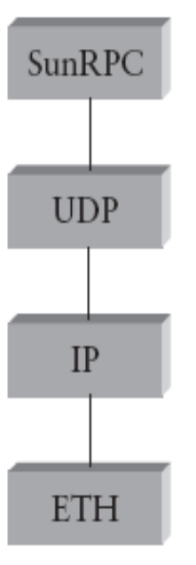

Slide 92
SunRPC implements the core request/reply algorithm; SunRPC uses two-tier addresses to identify remote procedures: a 32-bit program number and a 32-bit procedure number.
For example, the NFS server has been assigned program number x00100003, and within this program, getattr is procedure 1, setattr is procedure 2, read is procedure 6, write is procedure 8, and so on. Each program is reachable by sending a message to some UDP port. When a request message arrives at this port, SunRPC picks it up and calls the appropriate procedure
To determine which port corresponds to a particular SunRPC program number, there is a separate SunRPC program, called the Port Mapper, that maps program numbers to port numbers. The Port Mapper itself also has a program number (x00100000) that must be translated into some UDP port.

Slide 93
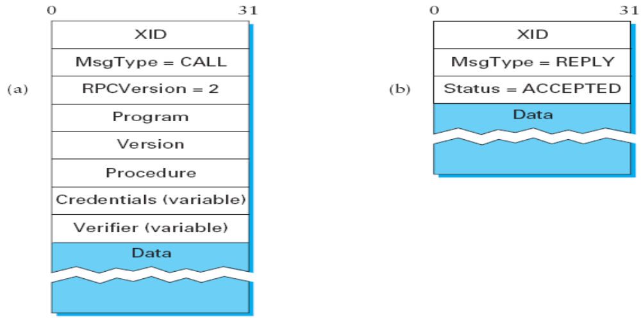
SunRPC header formats: (a) request; (b) reply

Slide 94
DCE-RPC
The Distributed Computing Environment (DCE) defines another widely used RPC protocol, which we call DCE-RPC DCE is a set of standards and software for building distributed systems. It was defined by the Open Software Foundation (OSF),
DCE-RPC is designed to run on top of UDP. It is similar to SunRPC in that it defines a two-level addressing scheme: UDP demultiplexes to the correct server, DCE RPC dispatches to a particular procedure exported by that server, and clients consult an “endpoint mapping service” (similar to SunRPC’s Port Mapper) to learn how to reach a particular server. DCE-RPC implements at-most-once call semantics

